Slide 1

Metrocar Customer Funnel Analysis
Vanessa Kimana

Slide 2

Project Background
Metrocar operates as a ride-sharing platform
Connects riders with drivers through a mobile application
Acts as an intermediary between riders and drivers
Analyze Metrocar's customer funnel for improvement

Slide 3
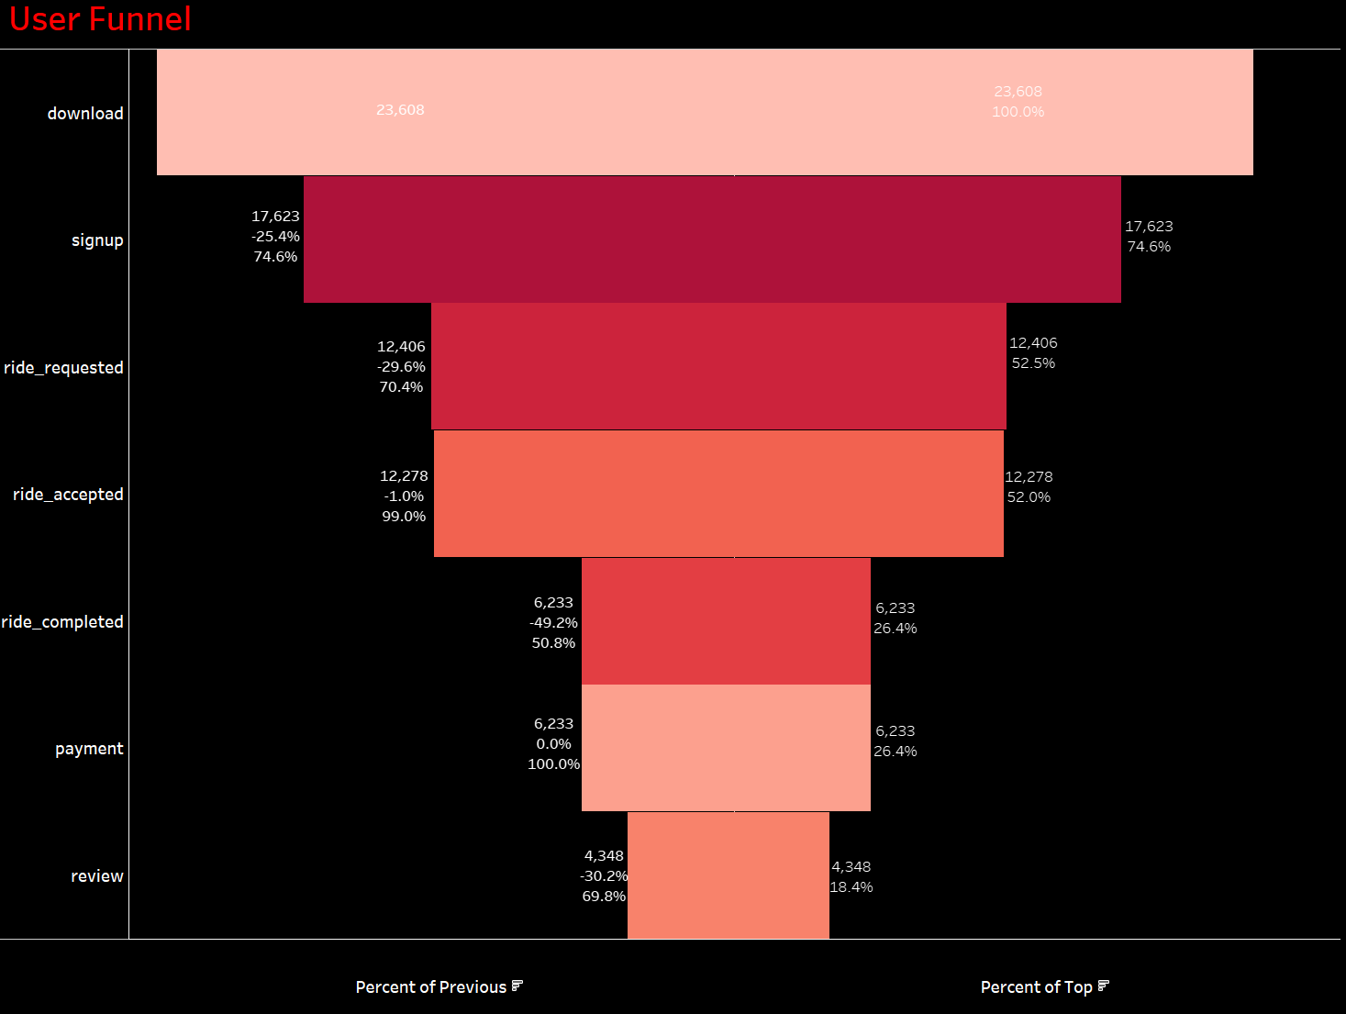
User Funnel Analysis
Metrocar total users: 23,608
Substantial drop in users from "Download" to "Signup" of 25%.
Significant drop-off between "Ride Accepted" and "Ride Completed.“ of 29%.
Noticeable drop-off at the "Review" stage of 30%.
While the overall conversion rate is relatively high, it's essential to understand the reasons behind the drop-offs.

Slide 4
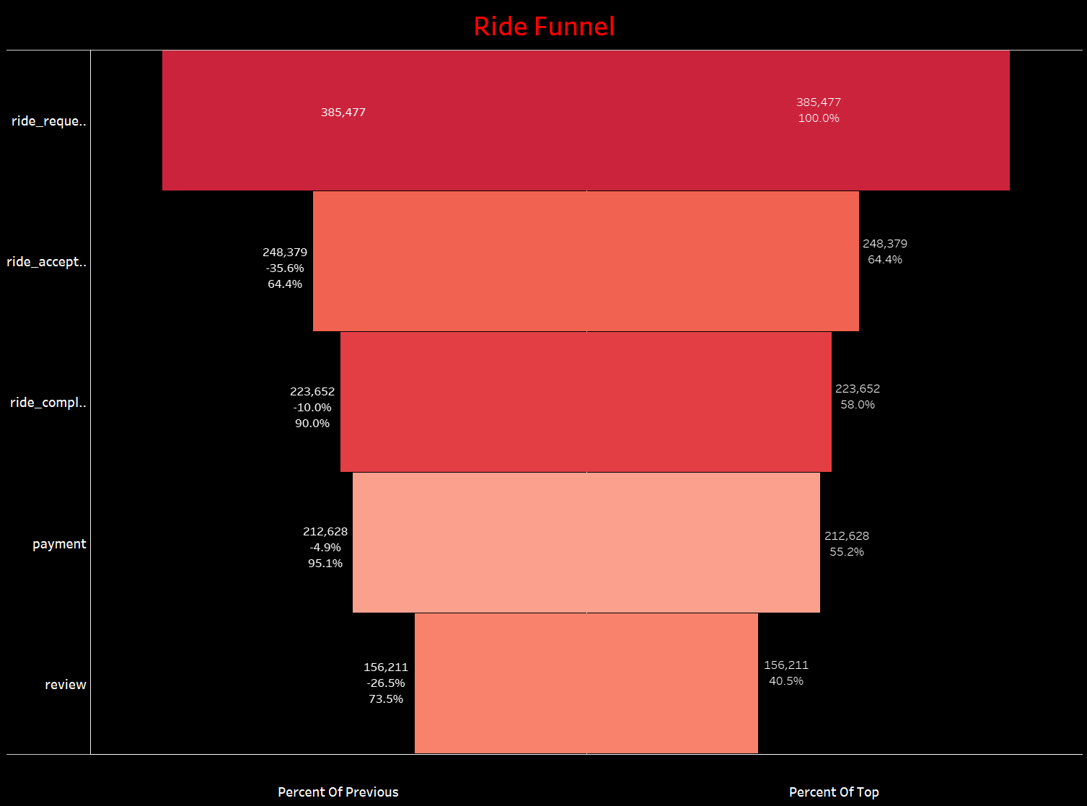
Ride Funnel Analysis
The "Ride Request" stage has a high number of ride requests of 385,477.
64.4% of users who requested a ride had their requests accepted by drivers.
Low drop off in the payment stage 4%, 55.2% of the people who finished their ride successfully made a payment in the entire process.
The Review stage experiences a significant drop-off rate of 26.5%, indicating challenges in completing the review process.

Slide 5
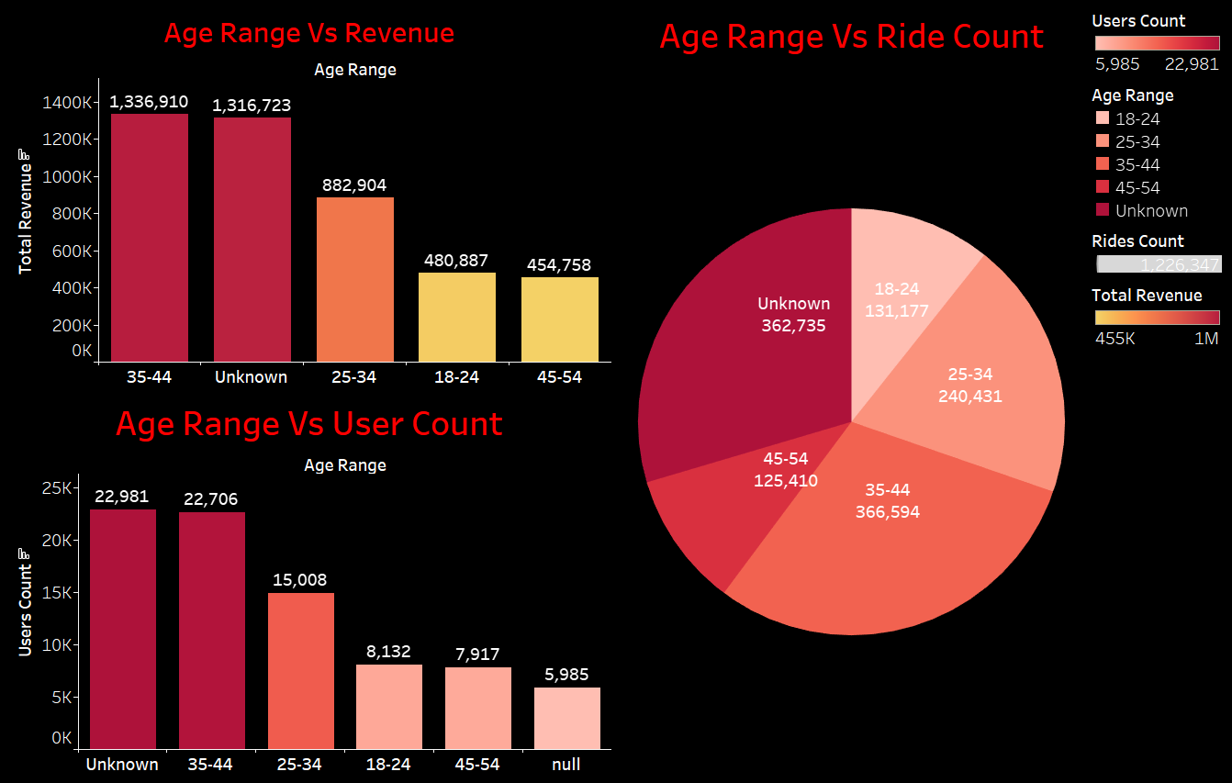
Age Range, Revenue & Rides Analysis
The unknown category represents the highest revenue.
The age range of 35-44 stands out as the highest contributor to revenue.
The youngest users are between18-24 age range and contributes a substantial $480,887 in revenue.
The largest user count comes from the 35-44 age range, followed by 25-34 and then 18-24. The "Unknown" category also has a substantial user count.

Slide 6
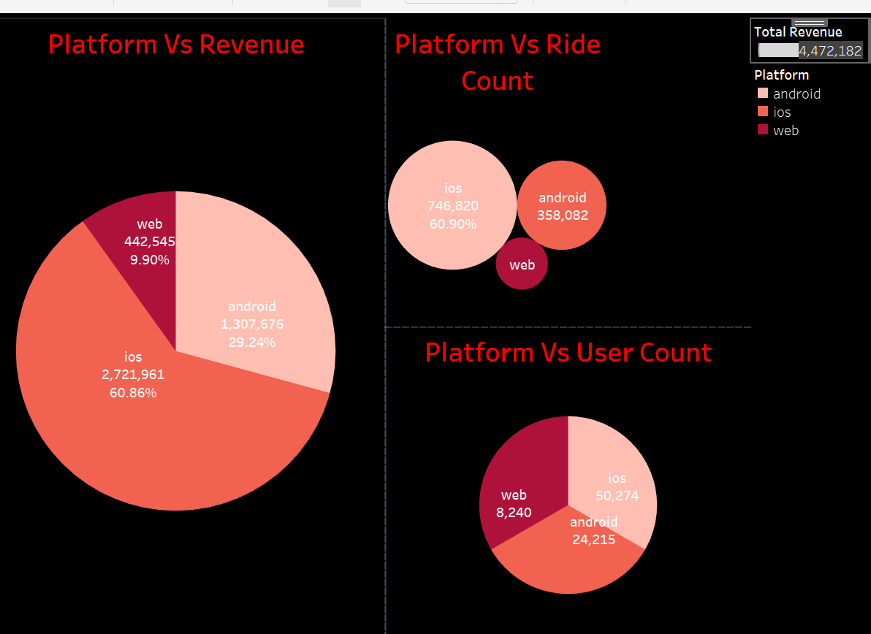
Platform, Revenue, Ride & User Count Analysis
IOS is leading in terms of revenue source and user count, representing 60.86% of total base.
Android is the second-largest platform, both in terms of user count and revenue.
The web platform, though the smallest contributes 9.90% of the total.

Slide 7
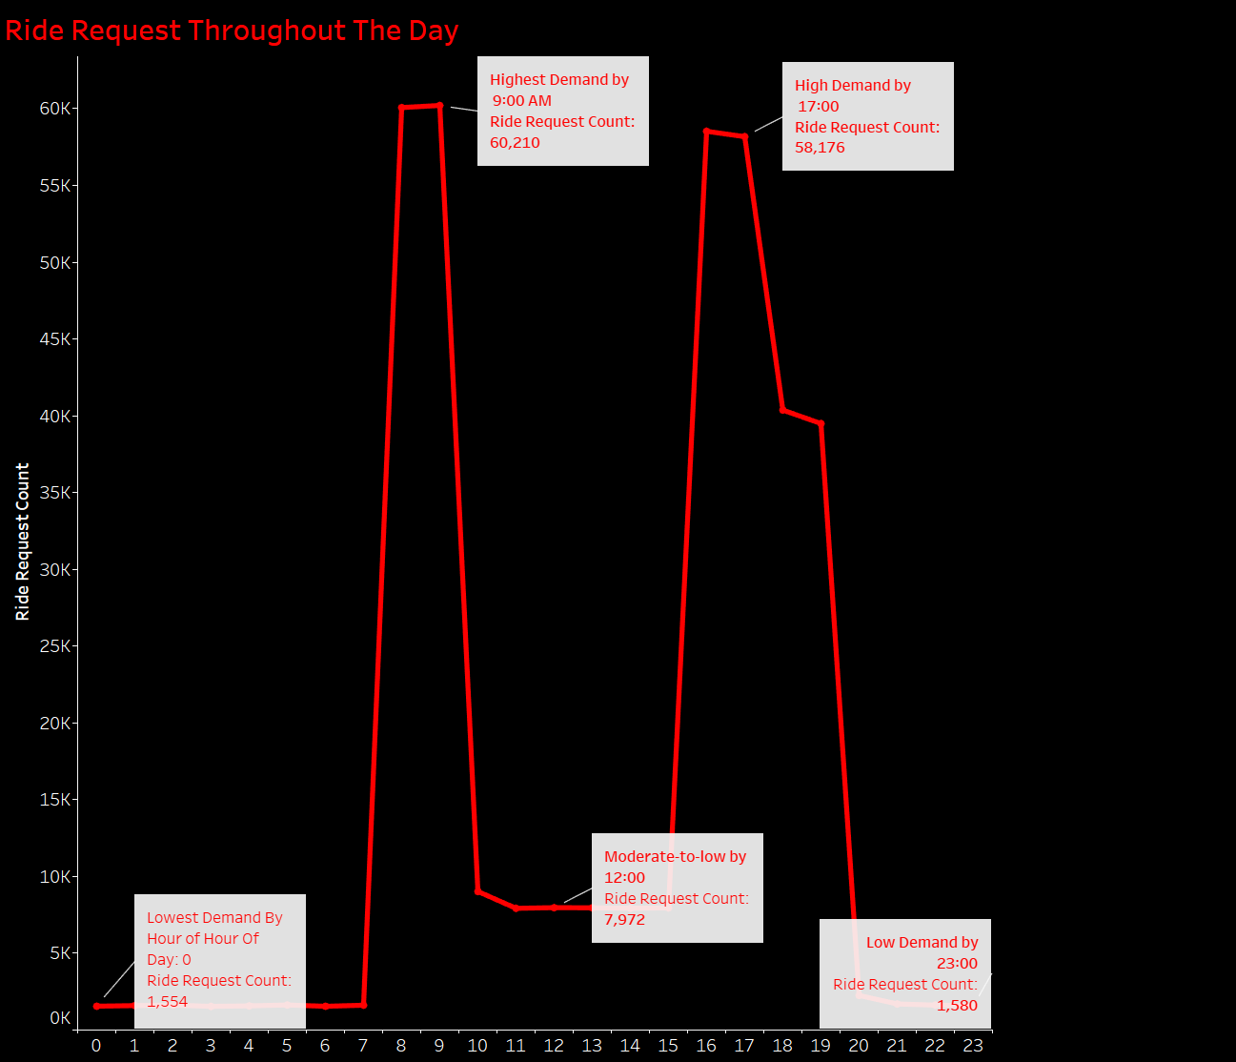
Ride Request Throughout The Day
Significant demand in ride requests during rush hours, Peak Hours (8:00 AM - 9:00 AM, 5:00 PM - 6:00 PM).
Notable activity during the late-night hours, indicating a moderate request for rides.
The hours between 00:00 and 05:00 show lowest ride requests, indicating off-peak hours.

Slide 8
Areas of improvement and Optimization
Optimize the user funnel by improving the signup process to address the 25.4% drop-off prior download step, enhancing ride request engagement to focus on the 29.6% drop-off and optimize the review process to encourage more users to provide feedback.
Optimize the ride funnel by addressing the 35.6% drop-off between ride request and acceptance, explore user friendly payment step by minimizing the 4.9% drop-off and encouraging more riders to leave feedback
Implementing strategies to capture the demographics within this “unkown” category. Intensify marketing for the lucrative 35-44 age group to increase engagement.
Focus on iOS for revenue optimization (60.86%) and enhance Android engagement (29.24%).
Implement surge pricing during peak hours, particularly during morning and evening rush hours, to maximize revenue during high-demand periods. Enhance dynamic pricing adjustments during late-night hours to optimize earnings during periods of off peak.

Slide 9

END OF PRESENTATION

